Slide 1
Chapter | Content
1 | The Purpose and Use of Financial Statements
2 | A Further Look at Financial Statements
3 | The Accounting Information System
4 | Accrual Accounting Concepts
5 | Merchandising Operations
6 | Reporting and Analyzing Inventory
7 | Internal Control and Cash
8 | Reporting and Analyzing Receivables
9 | Reporting and Analyzing Long-Lived Assets
10 | Reporting and Analyzing Liabilities
11 | Reporting and Analyzing Shareholders' Equity
12 | Reporting and Analyzing Investments
13 | Statement of Cash Flows
14 | Performance Measurement
https://ca.finance.yahoo.com/
https://www.sec.gov/edgar.shtml

Slide 2
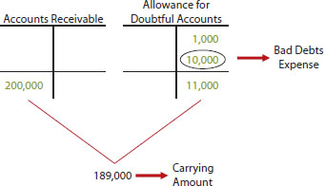
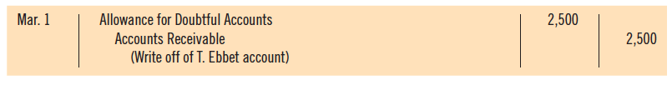
Ch 8 Account Receivables
Losses from uncollectible receivable accounts ➔debited to Bad Debts Expense account
Bad debts expense is recognized in the same period that the related sales revenue is generated

Slide 3
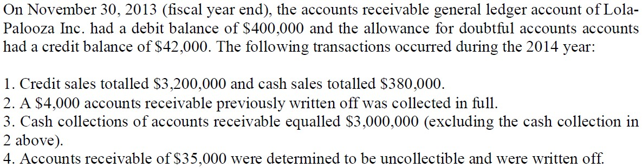
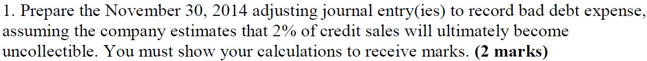
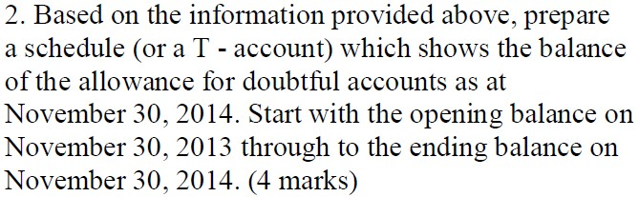
Accounting for Bad Debt Expense (Example)
AFDA

Slide 4
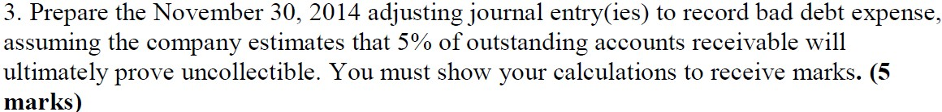
Accounting for Bad Debt Expense (Example)
AR
AFDA
Begin.
Begin. 42,000

Slide 5
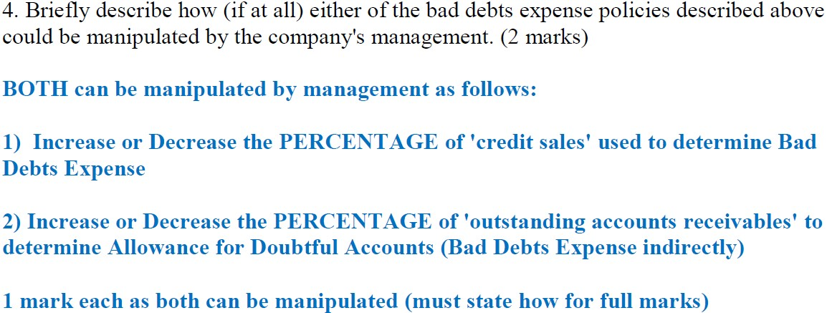
Accounting for Bad Debt Expense (Example)

Slide 6
CH9: Reporting and Analyzing Long-Lived Assets
Determine the cost of property, plant and equipment.
Calculate depreciation.
Derecognition of property, plant, and equipment.
Accounting issues for intangible assets and goodwill.
How long-lived assets are reported in the financial statements.
Evaluating the use of assets.

Slide 7
Property, Plant, and Equipment
Long-lived resources that
Are controlled by the company
Are tangible (have physical substance)
Are used in the operation of a business
Are not intended for sale to customers
Provide economic benefits over many years

Slide 8
Determining the Cost of Property, Plant and Equipment
Recorded at cost, which includes
Purchase price, including non-refundable taxes and duties, less discounts or rebates
Estimated cost of future obligations to dismantle, remove or restore the asset at the end of its useful life
Expenditures necessary to bring asset to its intended location and make it ready for its intended use

Slide 9
Types of Expenditures (At and Subsequent to acquisition)
Operating expenditures
Benefit only the current period
Immediately charged as an expense
Capital expenditures
Capitalized as an asset (increases the cost of the asset)
Benefit future periods
Increases a company’s investment in productive activity

Slide 10
Land
Cost of land includes
Purchase price
Closing costs such as title and legal fees
Additional costs to prepare land for its intended use (less any proceeds from salvage)
Land has an unlimited life, therefore it is not depreciated

Slide 11
Land Improvements
The costs of structural additions made to land (such as paving, fencing, and sidewalks)
These decline in service potential over time
They are recorded separately from land
Depreciated over their useful lives
Will not include costs of getting the land ready to use

Slide 12
Buildings
All expenditures related to the building purchase / construction
When a building is purchased such costs include
Purchase price
Closing costs (legal fees)
Costs required to make building ready for its intended use
When a building is constructed, its cost consists of
Contract price
Architect's fees
Building permits
Excavation cost
Interest costs during construction
Notes:
a land excavator prepares a site for development by removing trees, digging and grading the land in preparation for home foundations.

Slide 13
Equipment
Costs include
Purchase price
Freight charges and insurance during transit paid by the purchaser
Assembling
Installing and testing

Slide 14
Buy or Lease?
Advantages of leasing
Reduced risk of obsolescence
100% financing
Income tax advantages
Terminology
Lessor — owner of asset for lease (such as a landlord)
Lessee — party leasing asset from owner (such as a tenant)

Slide 15
Buy or Lease? (Continued)
Operating lease
Treated as rental by lessee
Periodic payment (rent expense)
No asset (no ownership) recorded by the company
Finance lease
Treated as purchase by lessee (as an asset and corresponding liability)
Periodic payment (decrease liability and charge interest expense)

Slide 16
Factors in Calculating Depreciation
Depreciation: Systematic allocation of the cost of property, plant and equipment over the asset’s useful life
Cost
Purchase price plus costs required to get the asset ready for use plus estimated asset retirement costs
Useful life
The period of time that the asset is expected to be available for use, or
The number of units that the asset is expected to produce or units of output expected to be obtained
Residual value
Estimated amount to be received at the end of the asset’s useful life

Slide 17
Depreciation Methods
Straight-line
Used by the majority of Canadian publicly-traded companies
Diminishing-balance
Units-of-production
Management chooses the method that best reflects the pattern of use of the economic benefits from that asset

Slide 18
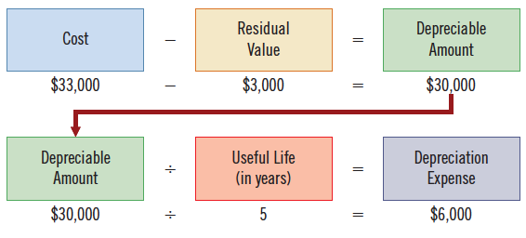
Straight-Line Method
Depreciation is constant for each year of the asset's useful life

Slide 19
Example – Depreciation Methods
A van was bought on Jan. 1, 2018 at $33,000, Estimated residual value: $3,000, Estimated useful life in years: 5
Estimated useful life (in kilometres): 100,000
Straight-Line Depreciation Schedule
 |  |  |  |  |  | End of Year
Year | Depreciable Amount | × | Depreciation Rate | = | Depreciation Expense | Accumulated Depreciation | Carrying Amount
 |  |  |  |  |  |  | $33,000
2018 | $30,000 |  | 20% |  | $ 6,000 | $ 6,000 | 27,000
2019 | 30,000 |  | 20% |  | 6,000 | 12,000 | 21,000
2020 | 30,000 |  | 20% |  | 6,000 | 18,000 | 15,000
2021 | 30,000 |  | 20% |  | 6,000 | 24,000 | 9,000
2022 | 30,000 |  | 20% |  | 6,000 | 30,000 | 3,000
 |  |  |  |  | $30,000

Slide 20
Eg. Warren Company plans to depreciate a new building using the straight-line depreciation method. The building was purchased for $800,000 at January 1st 2019. The estimated residual value of the building is 0 and it has an expected useful life of 25 years. A). At the end of the third year, what is the building’s book value, and Accumulated Depreciation?
BV: $704,000; Accum. Dep. $: 64,000
BV: $800,000; Accum. Dep. $: 96,000
BV: $704,000; Accum. Dep. $: 32,000
BV: $704,000; Accum. Dep. $: 96,000
Notes:
D Expenses being too low, net income being overstated and assets being overstated.
Not recording depreciations understates accumulated depreciation thus the impact on assets.

Slide 21
Eg. Warren Company plans to depreciate a new building using the straight-line depreciation method. The building was purchased for $800,000 at January 1st 2019. The estimated residual value of the building is 0 and it has an expected useful life of 25 years. B). If the firm did not record the depreciation expense for 2020, what should be the journal entry amount at the end of 2021?
$: 64,000
$: 96,000
$: 32,000
$704,000
Notes:
D Expenses being too low, net income being overstated and assets being overstated.
Not recording depreciations understates accumulated depreciation thus the impact on assets.

Slide 22
Warren Company plans to depreciate a new building using the straight-line depreciation method. The building was purchased for $800,000 at January 1st 2019. The estimated residual value of the building is 0 and it has an expected useful life of 25 years.
B. If the firm did not record the depreciation expense for 2020, what should be the journal entry at the end of 2021?

Slide 23
Diminishing-Balance Method
Produces a decreasing annual depreciation expense over an asset’s useful life
Based on the asset’s carrying amount, diminishing each year as accumulated depreciation increases
Annual depreciation expense = carrying amount at the beginning of the year X depreciation rate
Residual value is not included in the calculation
Can be applied using different rates
Depreciation rate = Straight-line rate x multiplier

Slide 24
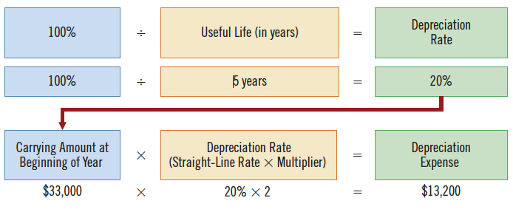
Diminishing-Balance Method

Slide 25
Double-Diminishing-Balance Depreciation Schedule: residual value of $3,000
 |  |  |  |  |  | End of Year
Year | Carrying Amount Beginning | × | Depreciation Rate | = | Depreciation Expense | Accumulated Depreciation | Carrying Amount
 |  |  |  |  |  |  | $33,000
2018 | $33,000 |  | 40% |  | $13,200 | $13,200 | 19,800
2019 | 19,800 |  | 40% |  | 7,920 | 21,120 | 11,880
2020 | 11,880 |  | 40% |  | 4,752 | 25,872 | 7,128
2021 | 7,128 |  | 40% |  | 2,851 | 28,723 | 4,277
2022 | 4,277 |  | 40% |  | 1,277* | 30,000 | 3,000
 |  |  |  |  | $30,000
* The calculation of $1,711 ($4,277 × 40%) is adjusted to $1,277 so that the carrying amount will equal the residual value of $3,000.

Slide 26
Units-of-Production Method
Useful life is expressed in terms of total units of production or activity expected from the asset
Such as units produced or machine-hours worked
Useful for factory machinery, vehicles, airplanes or any asset whose usage varies over time
Eg. A van costs 33,000, residual value 3,000, Estimated life: 100,000km or 10 years

Slide 27
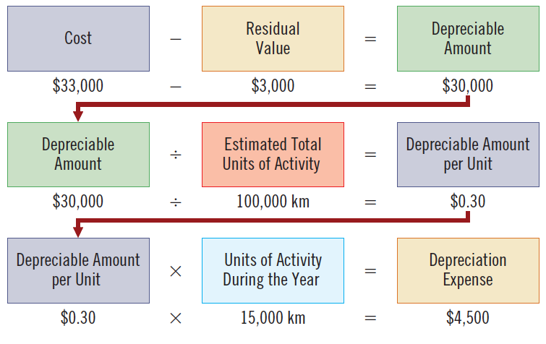
Units-of-Production Method

Slide 28
Units-of-Production Depreciation Schedule
Year | Units of Production | Depreciable Amount/Unit | Depreciation Expense | Accumulated Depreciation | Carrying Amount
 |  |  |  |  | $33,000
2018 | 15,000 | $0.30 | $ 4,500 | $ 4,500 | 28,500
2019 | 30,000 | 0.30 | 9,000 | 13,500 | 19,500
2020 | 20,000 | 0.30 | 6,000 | 19,500 | 13,500
2021 | 25,000 | 0.30 | 7,500 | 27,000 | 6,000
2022 | 10,000 | 0.30 | 3,000 | 30,000 | 3,000
 | 100,000 |  | $30,000

Slide 29
Comparison of Depreciation Methods
Straight-line | (Cost−Residual Value)/ Useful life
Diminishing-balance | (Cost−Accumulated Depreciation)×Depreciation Rate (Straight-Line Rate×Multiplier)
Units-of-production | (Cost−Residual Value)/(Total Estimated Units of Activity)×(Actual Units of Activity During the Year)
Cost: $33,000, Estimated residual value: $3,000, Estimated life in years: 5 Estimated life in kilometres: 100,000
 | Straight-Line |  | Diminishing-Balance |  | Units-of-Production
Year | Depreciation Expense | Carrying Amount | Depreciation Expense | Carrying Amount | Depreciation Expense | Carrying Amount
2018 | $ 6,000 | $27,000 | $13,200 | $19,800 | $ 4,500 | $28,500
2019 | 6,000 | 21,000 | 7,920 | 11,880 | 9,000 | 19,500
2020 | 6,000 | 15,000 | 4,752 | 7,128 | 6,000 | 13,500
2021 | 6,000 | 9,000 | 2,851 | 4,277 | 7,500 | 6,000
2022 | 6,000 | 3,000 | 1,277 | 3,000 | 3,000 | 3,000
 | $30,000 |  | $30,000 |  | $30,000

Slide 30

Other Depreciation Issues
Significant components
May be depreciated separately
Income tax
Impairments
Impairment loss (writedown): when carrying amount of asset exceeds its recoverable amount
Cost vs. revaluation model
Revaluation model allowed under IFRS to reflect their recoverable amount; used on a limited basis

Slide 31
Revising Periodic Depreciation
Revisions needed if
Capital expenditures during useful life
Impairment losses
Change in estimated useful life or residual value
Change in the asset’s economic benefits
Change made only in current and future years, but not to prior periods (prospective treatment)
 | Straight-Line |  | Diminishing-Balance |  | Units-of-Production
Year | Depreciation Expense | Carrying Amount | Depreciation Expense | Carrying Amount | Depreciation Expense | Carrying Amount
2018 | $ 6,000 | $27,000 | $13,200 | $19,800 | $ 4,500 | $28,500
2019 | 6,000 | 21,000 | 7,920 | 11,880 | 9,000 | 19,500
2020 | 6,000 | 15,000 | 4,752 | 7,128 | 6,000 | 13,500
2021 | 6,000 | 9,000 | 2,851 | 4,277 | 7,500 | 6,000
2022 | 6,000 | 3,000 | 1,277 | 3,000 | 3,000 | 3,000
 | $30,000 |  | $30,000 |  | $30,000

Slide 32
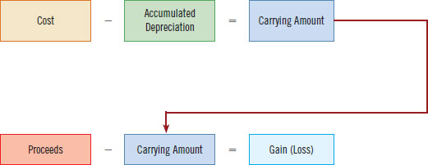
4 Steps of Derecognition of PPE
Update depreciation
Depreciation for the fraction of the year to the date of disposal must be recorded
Calculate carrying amount
Carrying amount = Cost – Accumulated depreciation
Calculate gain or loss
Proceeds – carrying amount = gain/loss
Record disposal: Remove cost of asset and accumulated depreciation. Record proceeds and gain or loss on disposition

Slide 33
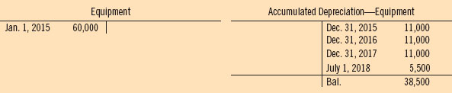


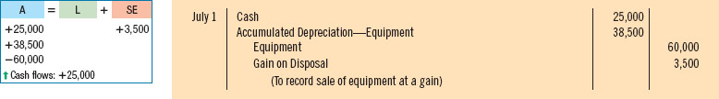
On July 1, 2018, Keystone Ltd. sells equipment for $25,000 cash. The equipment was purchased on January 1, 2015, at a cost of $60,000. At that time, it was estimated that the equipment would have a residual value of $5,000 and a useful life of 5 years. Makes adjusting entries annually at December 31 (straight-line dep.).
Straight-line method [($60,000 − $5,000) ÷ 5]= $11,000
Update any unrecorded depreciation (first 6 months of 2018)
Record the sale of the equipment

Slide 34

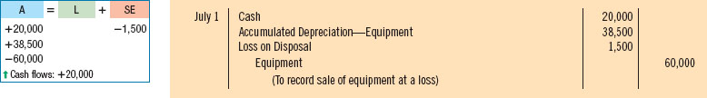

Loss
Assume now that, instead of selling the equipment for $25,000, Keystone sells it for $20,000.
In the earlier slides we have a disposal gain

Slide 35
RETIREMENT OF PPE
Continue with the Keystone example, and assume the equipment is retired at the end of its useful life, on January 1, 2020.
Depreciation expense would have been recorded for the full five years of the equipment's useful life.
Equipment |  |  | Acc. Dep.—Equipment
Jan. 1, 2015 | 60,000 |  | Dec. 31, 2015 | 11,000
 |  |  | Dec. 31, 2016 | 11,000
 |  |  | Dec. 31, 2017 | 11,000
 |  |  | Dec. 31, 2018 | 11,000
 |  |  | Dec. 31, 2019 | 11,000
 |  |  | Bal. | 55,000

Slide 36




RETIREMENT OF PPE
If Keystone is able to sell the equipment originally estimated
If no proceeds were received on disposal

Slide 37
Intangible Assets and Goodwill
Do not have physical substance
Rights, privileges and/or competitive advantages
For example, intellectual property in a production process
Must be identifiable
Can be separated from company and sold; or
Based on contractual or legal rights

Slide 38
Accounting for Intangible Assets
Parallels accounting for tangible assets
Recorded at cost including all costs to make asset ready for use
If intangible asset has a finite (limited) life, its cost must be systematically allocated over its useful life
Referred to as amortization rather than depreciation
Amortize over shorter of
Estimated useful life
Legal life
Indefinite (unlimited) life Intangible assets are not amortized

Slide 39
Intangibles with Finite Lives
Patents
Exclusive right to produce for 20 years
Research and development (R&D) costs
All research costs are expensed (Not Amortized)
expenditures are made but it is not yet known if these costs will have any future benefit.
Development costs are capitalized only if associated with an identifiable, feasible product
Copyrights ©
Protection for the life of the creator + 50 years

Slide 40






Intangibles with Indefinite Lives
Trademarks and trade names ™®
Word, phrase, jingle, symbol that distinguishes business
Franchises
Contractual arrangement to sell products or services
Licences
Rights to provide services as bus, taxi, telephone...
Ex. Rogers Comm. broadcasting NHL

Slide 41
Goodwill
Asset representing future economic benefits arising from the purchase of a business
Excess of cost over fair value of net identifiable assets (assets less liabilities) acquired
Represents the extra value relating to a business when it is purchased
Only identified with the business as a whole
Not amortized, but subject to an annual test for impairment

Slide 42
Presentation of Long-Lived Assets
Statement of Financial Position Reported
Property, Plant and Equipment
Intangible Assets
Goodwill
Disclose cost and accumulated depreciation (amortization) of each major class of assets
Either in statement or in notes
Disclose depreciation/amortization methods and useful lives or rates

Slide 43
Presentation of Long-Lived Assets
Income Statement
Depreciation expense, gains and losses on disposal and impairment losses are included in the operating section
Statement of Cash Flows
Cash flows from the purchase and sale of long-lived assets are reported in the investing section
https://ca.finance.yahoo.com/

Slide 44
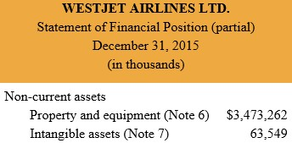
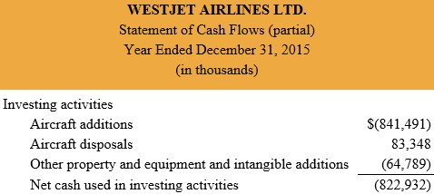
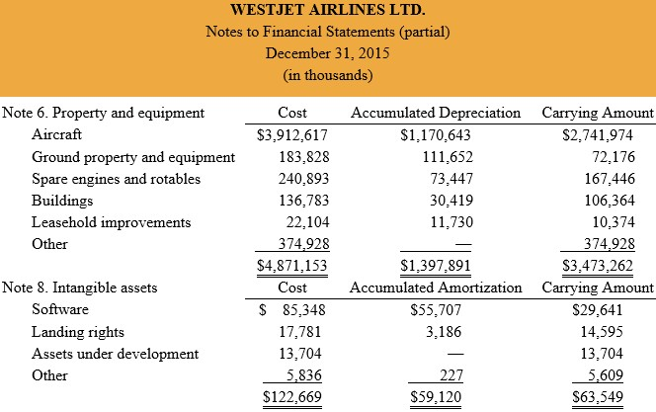

Slide 45

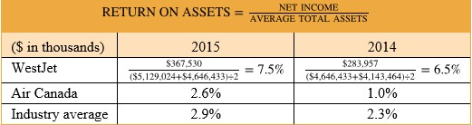
Return on Assets
Return on Assets = | Net Income
 | Average Total Assets
Measures overall profitability
Higher the better because it indicates that for every dollar invested in assets, more net income is being generated

Slide 46
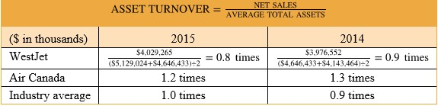
Asset Turnover
Asset Turnover = | Net Sales
 | Average Total Assets
Measures how efficiently a company uses its assets
Higher the better because it indicates that for every dollar invested in assets, more net income is being generated

Slide 47
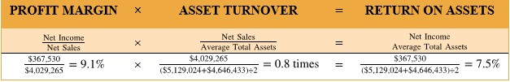
Profit Margin Revisited
Together, profit margin and asset turnover explain the return on assets ratio
ROA=NI/TA=NI/NS*NS/TA
Profit x Asset = Return on
Margin Turnover Assets

Slide 48
Midterm exam: Question 1
FCL owns Trapeze Equipment that was purchased on January 2, 2018, for $90,000. The equipment's estimated useful life is 8 years. FCL uses the straight-line method of depreciation.
Record the equipment purchase:
Prepare the year-end adjusting entry (if any) on October 31, 2018. (2 marks)

Slide 49
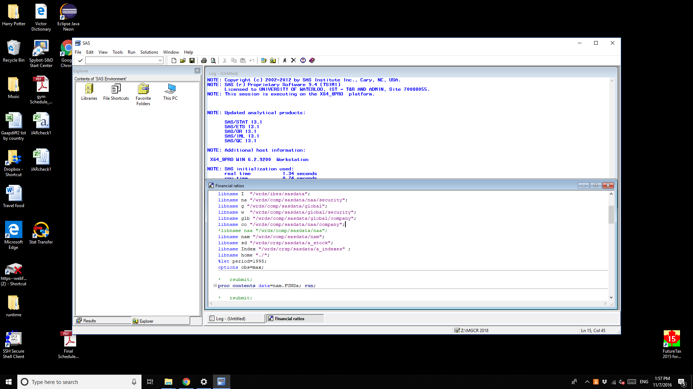

Slide 50
******** SAS codes to generate financial ratios for US firms since 1980 *******;
proc sql; *Compustat NAM Quarterly fundamentals;
create table compus as select unique *
from nam.FUNDa (keep=gvkey datadate act at sale ni teq dltt cogs invt ceq mkvalt epspx prcc_f)
where year(datadate)>=1980 and at>0 and sale>0;
quit; *362,378;
data ratio;
set compus;
PM=ni/sale;
ROA=ni/at;
ROE=ni/teq;
TAT=sale/at; *Total asset turnover;
PE=prcc_f/epspx;
IT=cogs/invt;
EM=at/teq;
year=year(datadate);
run;
proc means data=ratio nway mean median noprint;
class year;
var PM ROA ROE TAT EM IT PE;
output out=test(rename=(_freq_=freq) drop=_type_) median=PM ROA ROE TAT EM IT PE; run;
* rsubmit;
proc download data=test out=test; where year<2018; run;
PROC EXPORT DATA=test
OUTFILE= "C:\Users\Hongping\Dropbox\A MGCR211 2018\ratio.xls"
DBMS=xls REPLACE; run;

Slide 51
Financial ratios for US firms

